Slide 1


Competitive Analysis for UWE Bristol
Gonzalo Gamez
Name of the programme
Course

Slide 2
Content
Question
Scenario
Research
Objectives
Data
Conclusions
References

Slide 3

Question
Introduction
Why did you pick the university you studied at?

Slide 4
Scenario
Fig 1. UWE Bristol logo

Slide 5
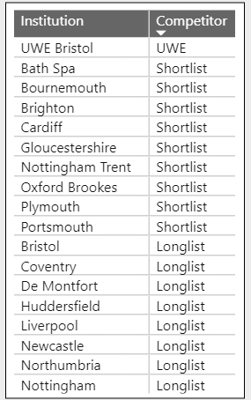
Scenario
Fig 1. UWE Bristol logo
Table 1. Table of universities listed as either "UWE" or competitors. Sorted by competitor type. 17 competitors (9 Shortlist, 8 Longlist)

Slide 6
Scenario
Fig 1. UWE Bristol logo
UWE: The University of the West of England (UWE) itself.
Shortlist: Universities that are strong competitors for students. These are institutions that prospective students are likely to seriously consider alongside UWE
Longlist: Universities that are also considered competitors, but they are generally considered to be less competitive or less likely to be a top choice for students compared to those on the shortlist.
Table 1. Table of universities listed as either "UWE" or competitors. Sorted by competitor type. 17 competitors (9 Shortlist, 8 Longlist)

Slide 7
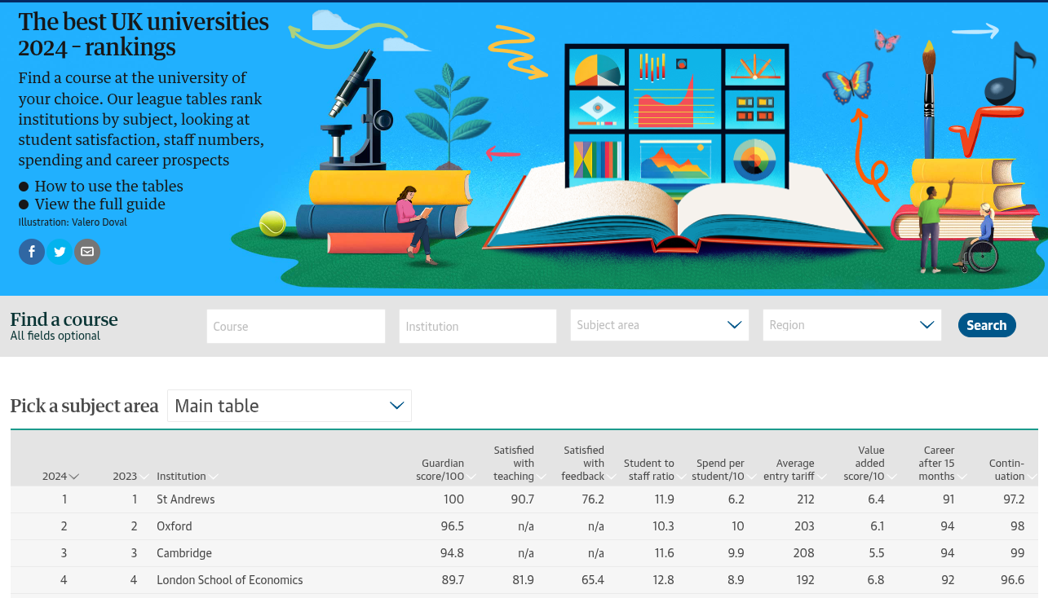
Scenario
Fig 2. The best UK universities 2024 – rankings.
Summary: Image presents a snapshot of The Guardian's university rankings, offering a way for students to compare UK universities based on a range of academic and career-related metrics

Slide 8
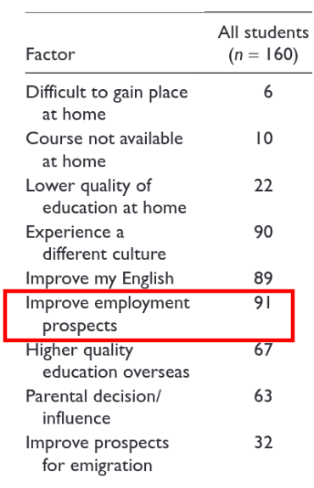

Research
2010
2017
2022
2024
2020
Fig 3. Timeline of research focused on UK Universities; red dot is when research was conducted
Research by Wilkins & Huisman (2010) highlighted for 160 international students in the UK. Their study showed that employment prospects (91%) and reputation (98%) are the most influential factors."
Fig 4. Factors as % influencing students' decision to study overseas (Wilkins and Huisman,2010) Summary: Rectangle shows the top reason for a student to study overseas in the UK
Fig 5. Table 3 top factor for choice of UK institution from research (Wilkins and Huisman,2010)
Summary: Reputation of university was the top factor for deciding which university to go to in UK​

Slide 9
Research
2010
2017
2022
2024
2020
Fig 3. Timeline of research focused on UK Universities; red dot is when research was conducted
Further research (McManus et al., 2017) confirms the importance of league table rankings, employment prospects, and tuition fees in university choice. However, the weight of these factors varies based on student demographics, such as gender, parental education, and international student status. A case study on Polish students in the UK (Rembielak et al., 2020) highlighted 'pull factors' like a multicultural environment, reputation, employability, facilities, and scholarships as key motivators.

Slide 10
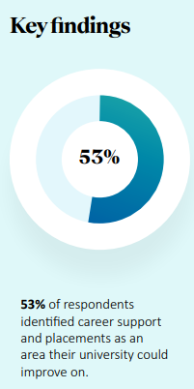
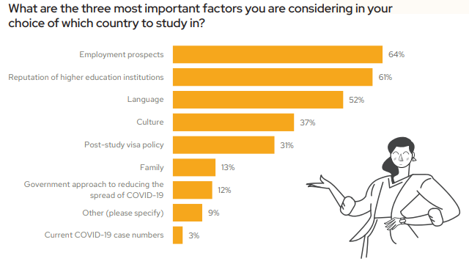
Research
2010
2017
2022
2024
2020
Fig 3. Timeline of research focused on UK Universities; red dot is when research was conducted
Fig 6. Survey of university students worldwide from QS (2022)
Summary: Shows that employment prospects and reputation are the most important factor for considering which country to study in
Fig 7. Insights of International Graduate Outcomes 2024 from QS (2024) Summary: provided from 10,000 international students who graduated from 37 UK universities provided by QS over the past six years. 53% of respondents identified UK universities could improve in employment support.

Slide 11
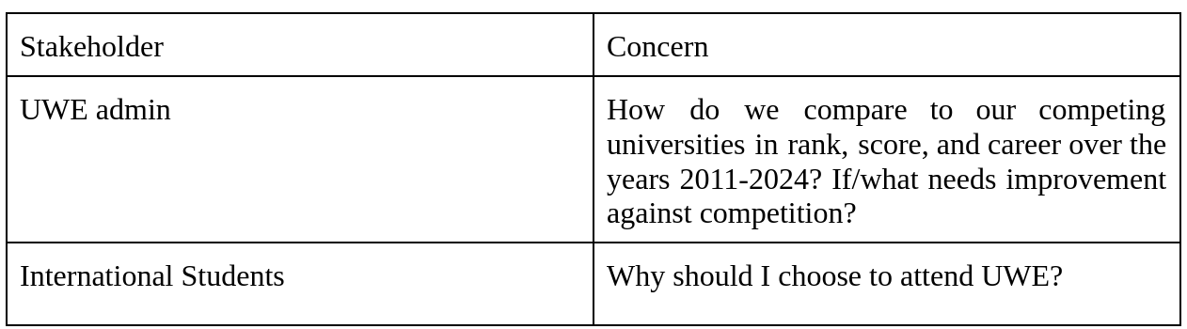
Objectives
Table 2. Stakeholder concerns
Table 1. Table of universities listed as either "UWE" or competitors. Sorted by competitor type. 17 competitors (9 Shortlist, 8 Longlist)

Slide 12
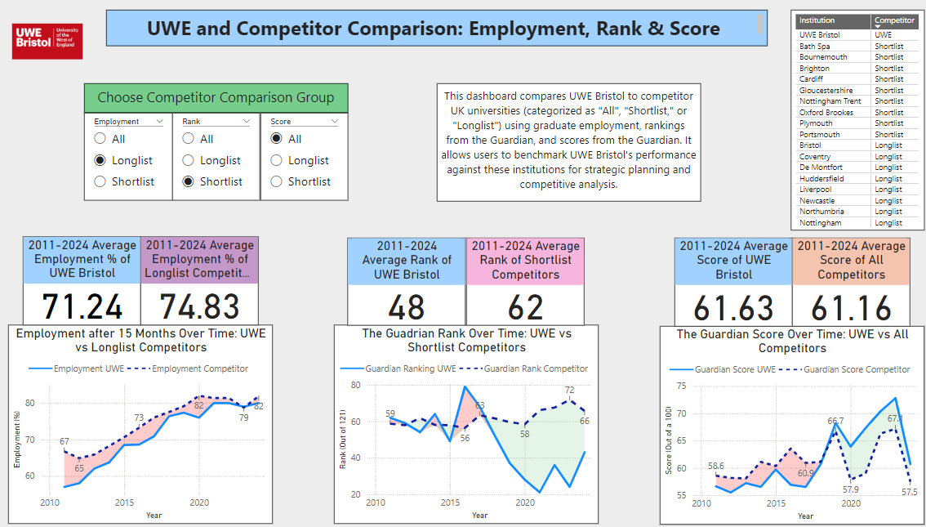
Data
Fig 8. Dashboard created to compare Employment, Rank & Score

Slide 13
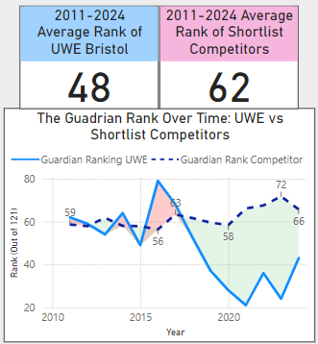
Data – Rank (lower is better)
Fig 9. UWE Bristol's Guardian University Rankings vs. Shortlist Competitors (2011-2024)
Summary: Shortlist Competitors had a ranking that fluctuated between 56 and 72, consistently trailing UWE Bristol after 2017. UWE average rank from 2011-2024 was better than the average of Shortlist Competitors

Slide 14
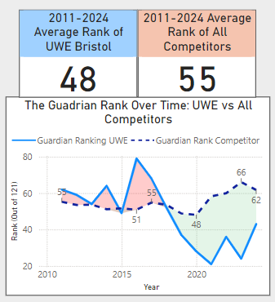
Data – Rank (lower is better)
Fig 9. UWE Bristol's Guardian University Rankings vs. Shortlist Competitors (2011-2024)
Summary: Shortlist Competitors had a ranking that fluctuated between 56 and 72, consistently trailing UWE Bristol after 2017. UWE average rank from 2011-2024 was better than the average of Shortlist Competitors
Fig 10. UWE Bristol's Guardian University Rankings vs. All Competitors (2011-2024)
Summary: All Competitors had a ranking that fluctuated between 51 and 66, consistently trailing UWE Bristol after 2017. UWE average rank from 2011-2024 was better than the average of All Competitors

Slide 15
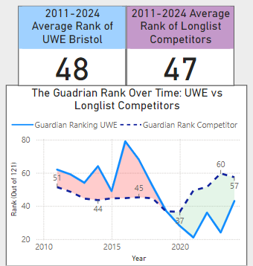
Data – Rank (lower is better)
Fig 9. UWE Bristol's Guardian University Rankings vs. Shortlist Competitors (2011-2024)
Summary: Shortlist Competitors had a ranking that fluctuated between 56 and 72, consistently trailing UWE Bristol after 2017. UWE average rank from 2011-2024 was better than the average of Shortlist Competitors
Fig 11. UWE Bristol's Guardian University Rankings vs. Longlist Competitors (2011-2024)
Summary: Longlist Competitors had a ranking that fluctuated between 37 and 60, consistently trailing UWE Bristol after 2018. UWE average rank from 2011-2024 was close to the average of Longlist Competitors

Slide 16
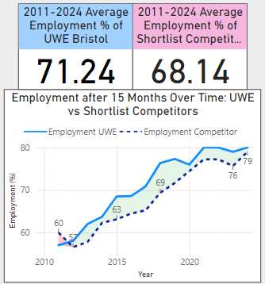
Data – Employment (%)
Fig 12. UWE Bristol vs Shortlist Competitors: Employment Rates After 15 Months (2011–2024)
Summary: Shortlist Competitors' employment rate generally lags UWE Bristol but trends upward. UWE average employment rate from 2011-2024 was better than the average of Shortlist Competitors

Slide 17
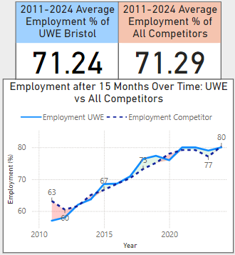
Data – Employment (%)
Fig 12. UWE Bristol vs Shortlist Competitors: Employment Rates After 15 Months (2011–2024)
Summary: Shortlist Competitors' employment rate generally lags UWE Bristol but trends upward. UWE average employment rate from 2011-2024 was better than the average of Shortlist Competitors
Fig 13. UWE Bristol vs All Competitors: Employment Rates After 15 Months (2011–2024)
Summary: UWE Bristol's employment rate closely tracks that of all competitors, with marginal fluctuations. Both trends improve over time. UWE average employment rate from 2011-2024 was close to the average of Shortlist Competitors

Slide 18
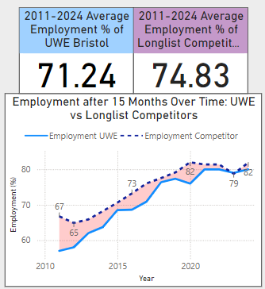
Data – Employment (%)
Fig 12. UWE Bristol vs Shortlist Competitors: Employment Rates After 15 Months (2011–2024)
Summary: Shortlist Competitors' employment rate generally lags UWE Bristol but trends upward. UWE average employment rate from 2011-2024 was better than the average of Shortlist Competitors
Fig 14. UWE Bristol vs Longlist Competitors: Employment Rates After 15 Months (2011–2024)
Summary: Shortlist Competitors' employment rate generally leads UWE Bristol, but trends upward. UWE average employment rate from 2011-2024 was worse than the average of Shortlist Competitors

Slide 19
Recommendations
Table 2. Stakeholder concerns
Concern: How do we compare to competing universities in rank, score, and career outcomes (2011-2024)? What areas need improvement?
Recommendation 1: Focus on Employment Outcomes: Data analysis indicates employment outcomes are the key area for improvement against competitors.
Recommendation 2: Benchmark Against Top Competitors: Focus benchmarking efforts on "longlist" competitors (top-performing institutions considered by prospective students).
Recommendation 3: Subject-Specific Dashboards: Develop dashboards for employment and rankings broken down by subject area.
Concern: Why should I choose to attend UWE?
Recommendation 1: Highlight Consistent Ranking Performance: Emphasize UWE's consistent ranking performance over the past 7 years compared to all competing institutions.
Recommendation 2: Promote Superior Employment Outcomes: Showcase UWE's average employment outcomes since 2011, which have consistently outperformed shortlisted institutions.
Recommendation 3: Targeted Marketing & Messaging: Conduct focus testing with the marketing team to refine messaging with data and ensure it resonates with international students.

Slide 20
Any Questions?
Introduction

Slide 21
References
Reference list
McManus, R., Haddock-Fraser, J. and Rands, P. (2017). A methodology to understand student choice of higher education institutions: the case of the United Kingdom. Journal of Higher Education Policy and Management, 39(4), pp.390–405. doi:https://doi.org/10.1080/1360080x.2017.1330806.
QS (2022). QS Higher Education Briefing: Is COVID-19 still impacting student decision-making? [online] QS.com. Available at: https://insights.qs.com/hubfs/Reports/CRE-904%20_May%202022-Briefing_V2%20(2).pdf?utm_medium=email&_hsmi=65742003&utm_content=65742003&utm_source=hs_automation.
QS (2024). International Graduate Outcomes 2024. [online] Available at: https://26055784.fs1.hubspotusercontent-eu1.net/hubfs/26055784/Reports/International%20Graduate%20Outcomes%20Report%202024.pdf [Accessed 2 Jan. 2025].
Rembielak, G., Rashid, T. and Parlińska, A. (2020). FACTORS INFLUENCING STUDENTS’ CHOICES AND DECISION- -MAKING PROCESS: A CASE STUDY OF POLISH STUDENTS STUDYING IN A BRITISH HIGHER EDUCATION INSTITUTION. Acta Scientiarum Polonorum. Oeconomia, 19(3), pp.85–95. doi:https://doi.org/10.22630/aspe.2020.19.3.31.
Wilkins, S. and Huisman, J. (2010). Student Recruitment at International Branch Campuses: Can They Compete in the Global Market? Journal of Studies in International Education, 15(3), pp.299–316. doi:https://doi.org/10.1177/1028315310385461.

